Slide 1
Plot Types in Matplotlib

Slide 2
When and How to Include Data Vis?
Overall rationale for including visualizations and how to choose one
What’s your purpose?
Present the data
Explain the data
Predict from the data
What chart style to pick?
There are many styles and different work areas tend to use certain styles.
The Data
Categorical, Metric, Geo-spatial, Datetime
Börner, K. Atlas of science. MIT Press.ç
Notes:
Metric means the interval are consistent - going from 1 to 2 is the same as 2-3 and 3-4

Slide 3
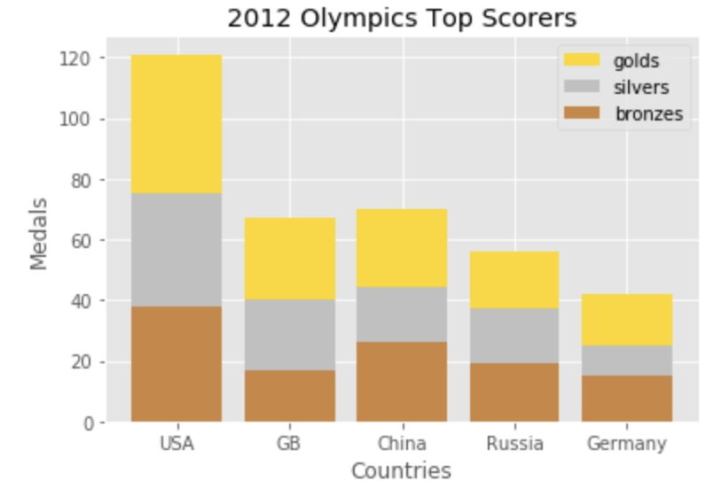
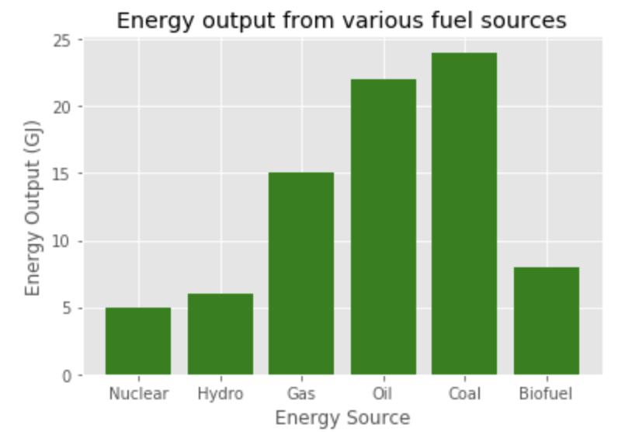
I Want to Compare Categories
Bar charts
Categorical x-variable
Metric y-variable (sometimes counts)

Slide 4
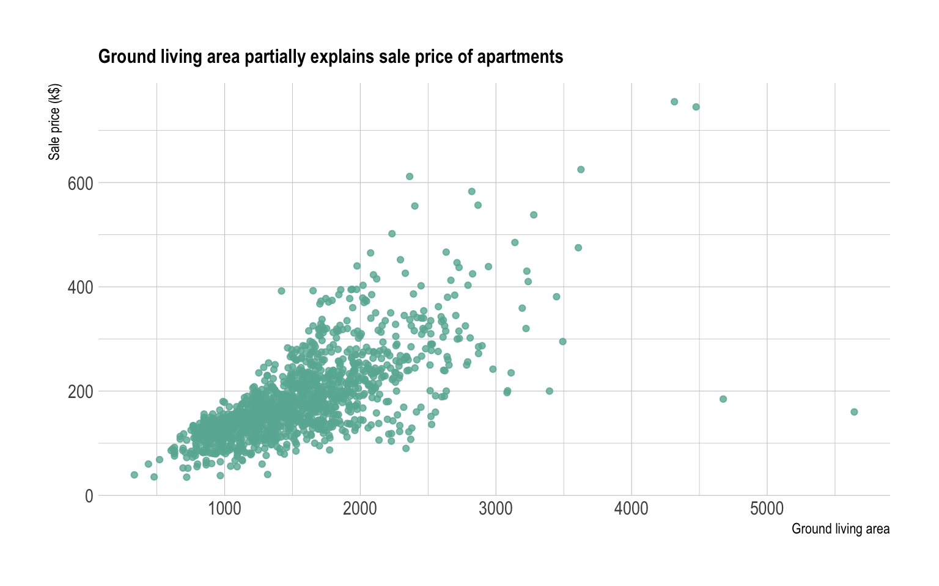
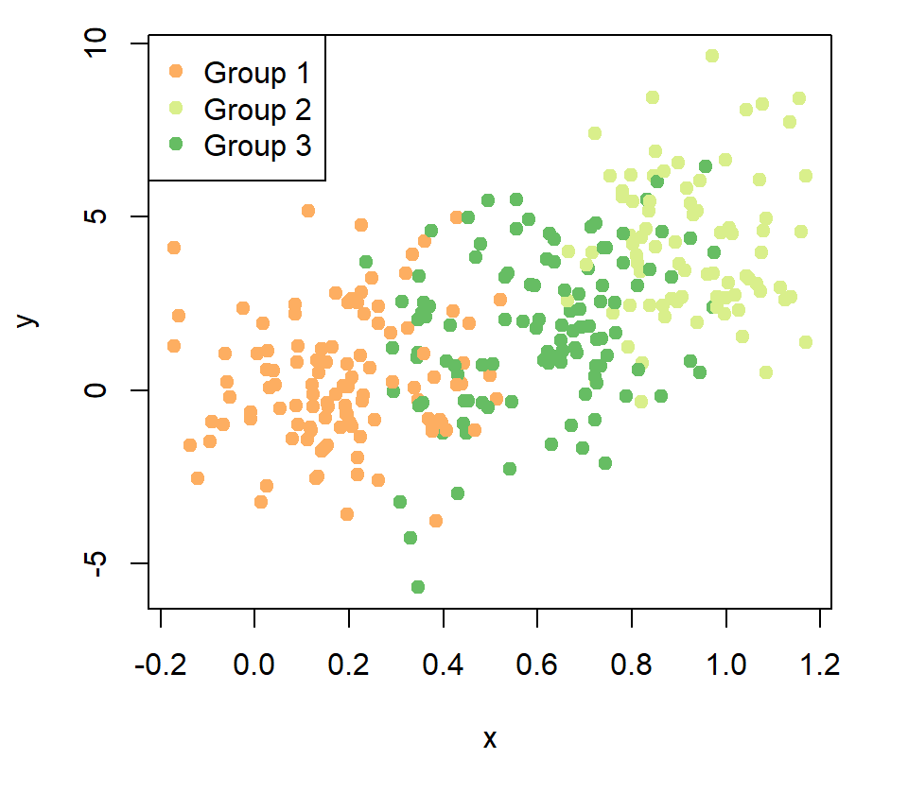
I Want to Plot Metric Relationships
Scatterplot
Metric x-variable
Metric y-variable
How would you plot 3 or 4 variables?
Add color
Add size of dots
https://matplotlib.org/stable/gallery/shapes_and_collections/scatter.html

Slide 5
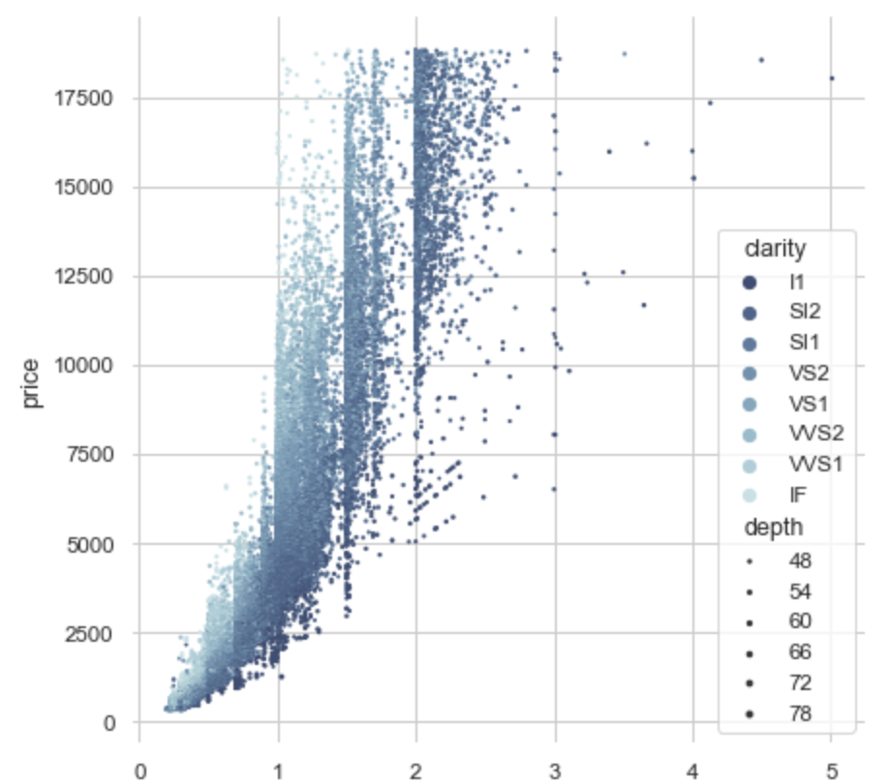
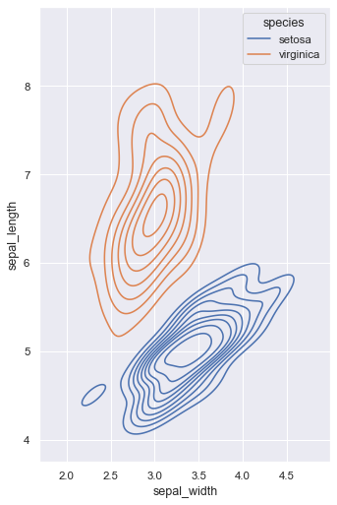
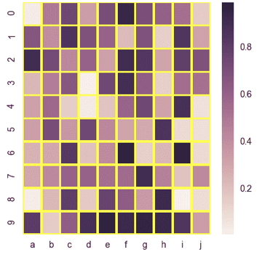
I Want to Plot Metric Relationships
From the basic plot you can adjust as data dictate
Scatter plot with a lot of data
kde plot
Heatmap: 2-d plot of relationships but notice each node suggests deeper trends
https://seaborn.pydata.org/examples/different_scatter_variables.html

Slide 6
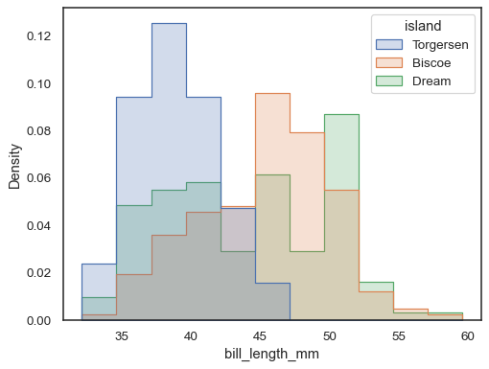
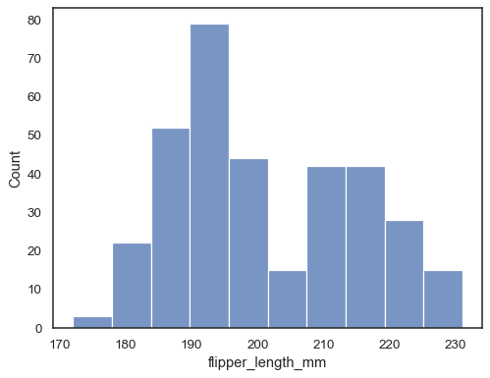
I Want to Plot Distributions
Histograms
One metric x-variable
Count or density on y-axis
https://seaborn.pydata.org/generated/seaborn.histplot.html

Slide 7
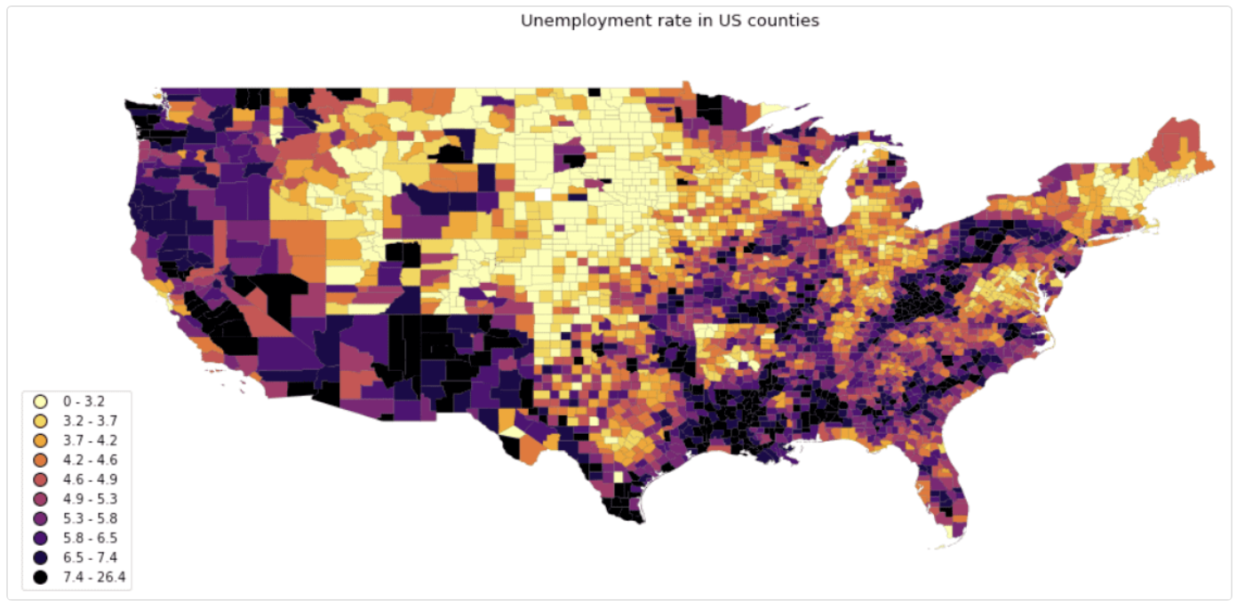
I Want to Plot Geospatial Data
Data on a Map
Geographic unit of observation
x-variable shaded on map
Notes:
Geospatial data
Usually use real-world maps as a background to contextualize the data.
Most use SVG (scalable vector graphics) maps as the basis and then plot data over the unit of measurement (say a state, country, county).
Akin to GIS (geographic information systems).
Used to show relationships between the geopolitical units and/or show changes to those units over time.

Slide 8
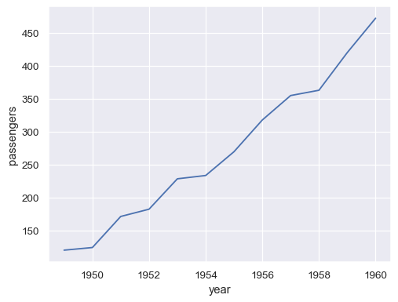
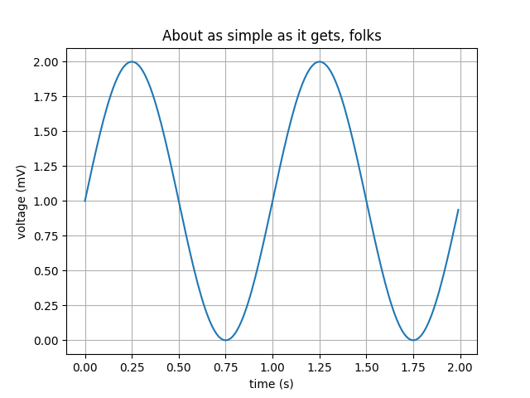
I Want to Plot Datetime Data
Line chart to show data over time
x-variable is date/times
y-variable is metric
Airline Passengers per year
https://matplotlib.org/stable/gallery/lines_bars_and_markers/simple_plot.html
https://seaborn.pydata.org/generated/seaborn.lineplot.html
Notes:
Geospatial data
Usually use real-world maps as a background to contextualize the data.
Most use SVG (scalable vector graphics) maps as the basis and then plot data over the unit of measurement (say a state, country, county).
Akin to GIS (geographic information systems).
Used to show relationships between the geopolitical units and/or show changes to those units over time.

Slide 9
Summary
I want to plot:
Distribution: density, histogram, box plot, violin, ridgeline
Correlation: scatterplot, heat map, correlogram, bubble, connected scatter, 2d density
Ranking: barplot, spider/radar, wordcloud, parallel, lollipop, circular barplot
Part/Whole: treemap (common in finance plotting), Venn diagram, donut, dendrogram, circular packing
Evolution: line chart, area chart, stacked area, steam graph, cladogram
Mapping: map, choropleth, hex bin, cartogram, connection, map bubble
Flow: network, sankey, chord, arc diagram, edge bundling

Slide 10
Plot Types in Matplotlib

